Slide 1
Elevator
Theory of Automata & Formal Languages
Group:
Nashra Ghaffar CT-20032
Abdul Rafay CT-20012
Anas bin Azim CT-20090
Mustafa Munir CT-20302

Slide 2
TABLE OF CONTENTS
01
03
02
04
DEFINITIONS
Working
Elevator & NFA
Working of elevator
using NFA
EXPLAINATION
RealWorld
Application
Explanation of process
with assumptions
Use of elevator

Slide 3
ELEVATOR
An elevator or lift is a cable-assisted, hydraulic cylinder-assisted, or roller-track assisted machine that vertically transports people or freight between floors, levels, or decks of a building, vessel, or other structure.
FINITE AUTOMATA
A finite state machine is a mathematical model of computation. It is an abstract machine that can be in exactly one of a finite number of states at any given time.
NFA
Non-Deterministic Finite Automata
Finite automata are called NFA when there exist many paths for specific input from the current state to the next state.

Slide 4
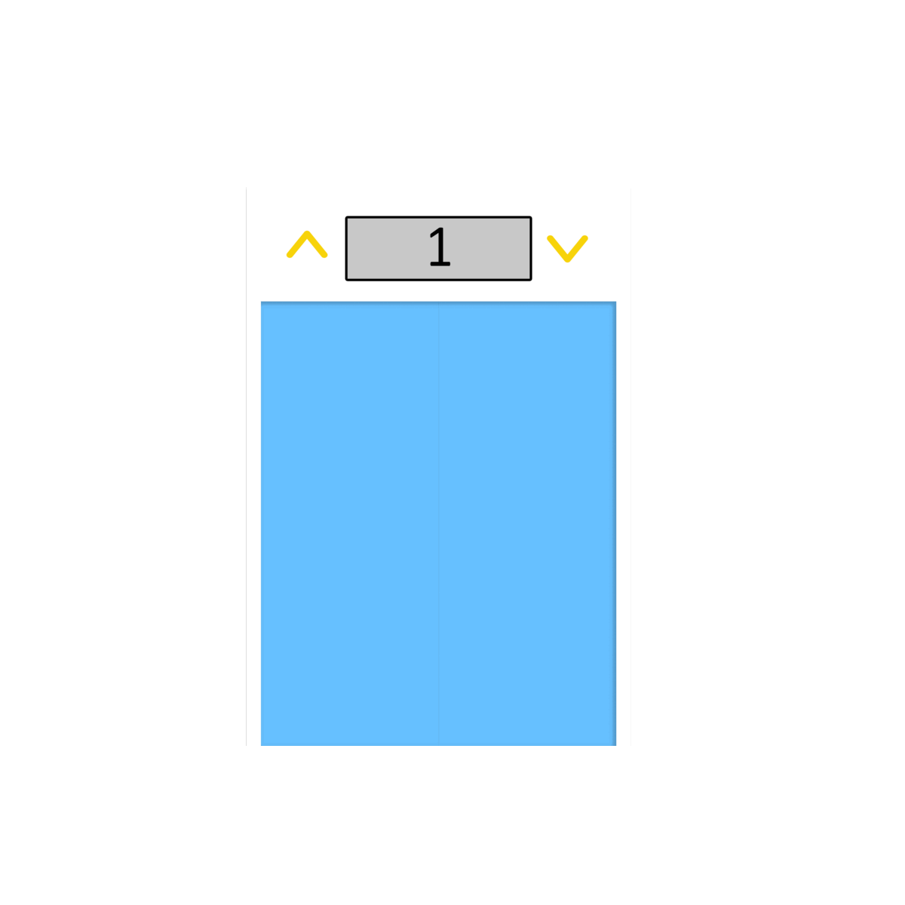
Working Of Elevator
The elevator will initially be in the rest state.
As soon as we select a floor, gate will close now we have transitioned to closed door state.
Now the lift will either move up or move down, according to the selected floor.
As the elevator stops it will then transition to arrived state & the door opens.
If there is a next floor selected the elevator’s gate then again closes, transitioning towards closed door state.

Slide 5
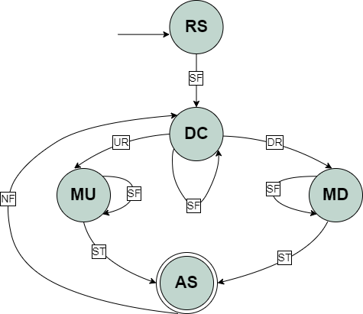

NFA of Elevator
Rest State | RS
Door Closed | DC
Moving Up | MU
Moving Down | MD
Arrived State | AR
Down Request | DR
Up Request | UR
Select Floor | SF
Next Floor | NF
Stopping | ST

Slide 6















Testing of Elevator with Accepted String
SACCEPTED = { SF DR SF ST NF UR ST , …}

Slide 7
Transition Table

Slide 8

Assumptions
Number of input of Next Floor will be equal to (n-1) times of Select Floor input.
As the elevator stops we will reach to required floor. Here input is assumed as stopping which will transition to arrived state.
DFA is not applicable according to the workflow of elevator.
Selecting a floor on Arrived State will transition to door closed state as Next Floor
Tuples
Input Symbols Σ = { SF, UR, DR, ST, NF }
Initial State → +Rest State (RS)
Final State -Arrived State (AR)
States = { RS, DC, MU, MD, AS }
SACCEPTED = { SF DR SF ST NF UR ST, … }
SREJECTED ={ SF UR NF, … } (In case of DFA)

Slide 9
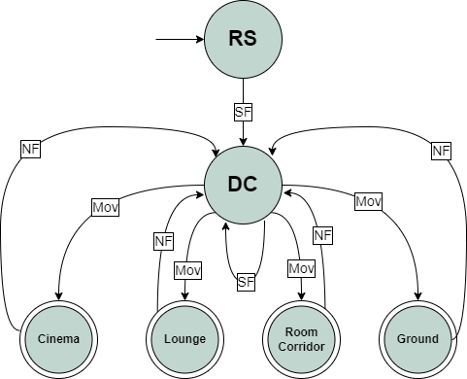





Real world use of Elevator
Rest State | RS
Door Closed | DC
Select Floor | SF
Moving | Mov
Next Floor | NF

Slide 10
QUESTIONS ?
If any, feel free to ask.

Slide 11

